Slide 1
Sprint 5 Demo
Tuesday, April 5th, 2022

Slide 2
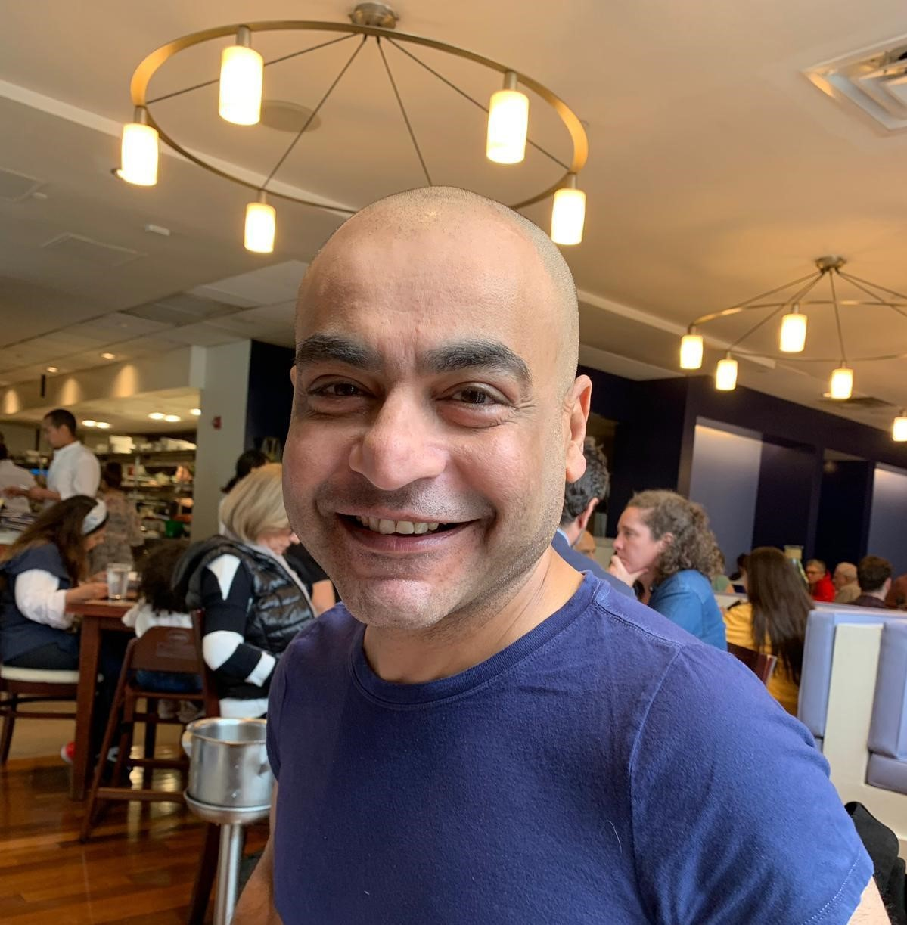

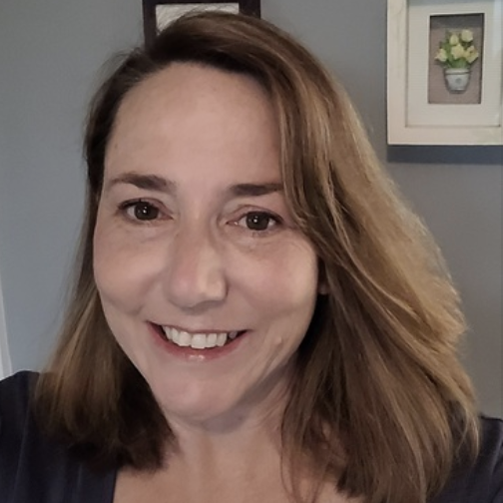










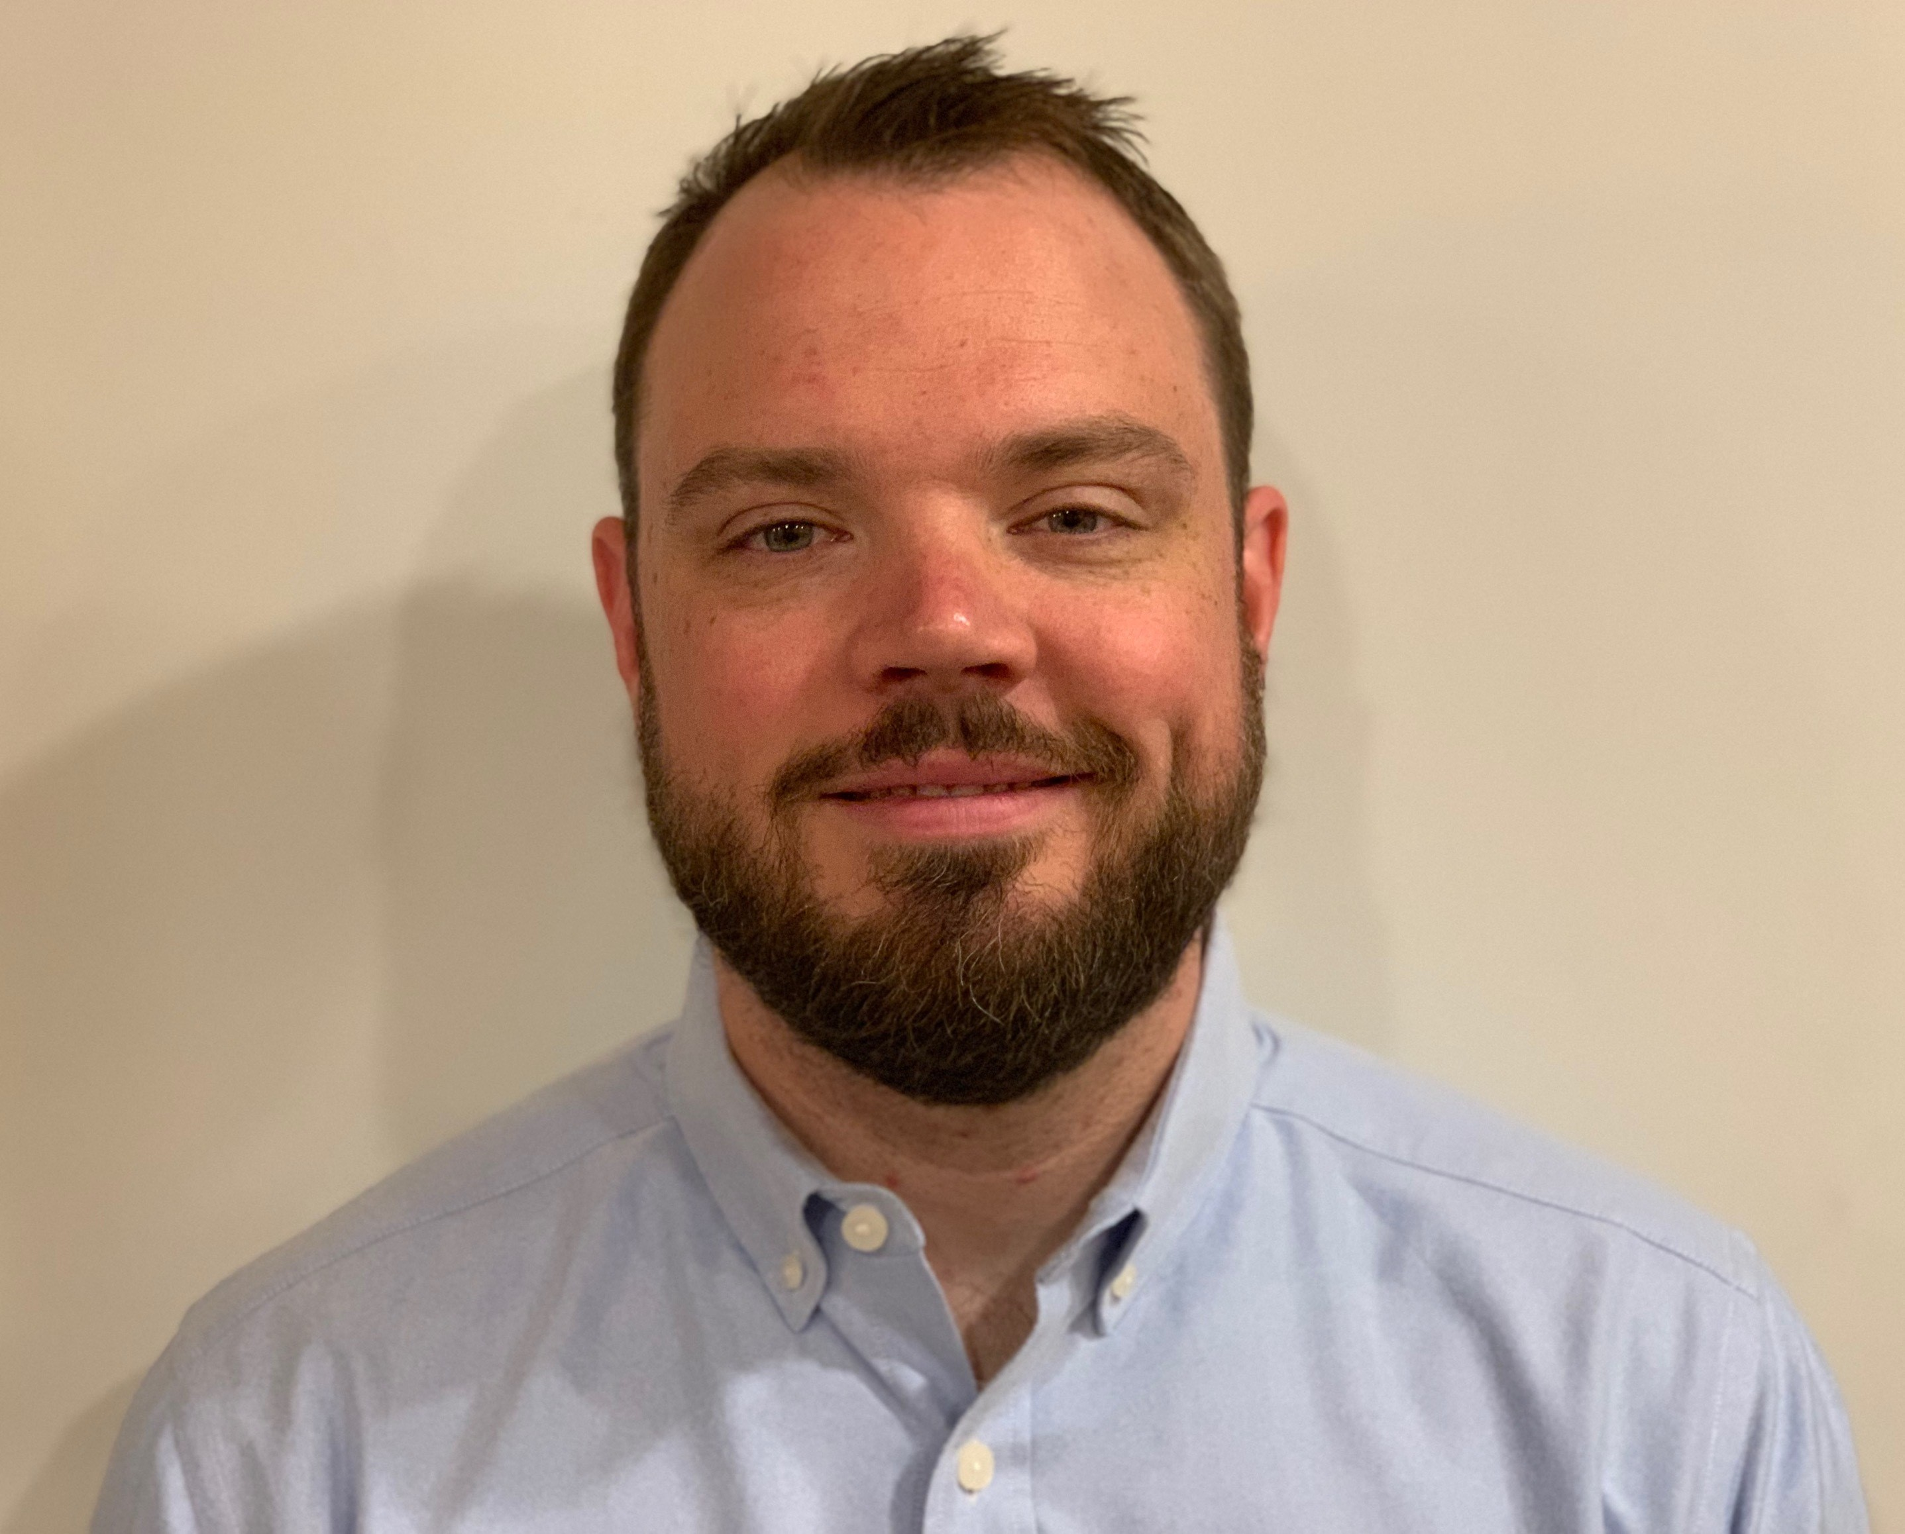
Get to know the team
Core team
Executive team
PRODUCT
ENGINEERING
Munish Sikka
Washington DC
Product Lead
Jordan White Dallas, TX Product Manager
Tami Corson
North Carolina
Scrum Master
Teagan Stephenson Ft. Lauderdale, FL Backend Engineer
Jeff Scheire
MO Studio
Marcy Jacobs
McKinsey
Kevin London Frog
DESIGN
Kit Casey Boston, MA Design Director
Carl Dickerson Atlanta, GA Content Strategist and Plain Language Content Creator
Grace Hong New Jersey Experience
Designer
James Lewis Austin, TX Accessibility and
UX Research Lead
Will Reynolds SERVE
Ben Morris
Pluribus
Travis Hoffmann
MO Studio
04-05 Sprint 5 Demo
Introduction

Slide 3



At the end of each sprint on Tuesdays, the team will run sprint reviews to showcase the sprint’s work for approval. The purpose of this meeting is:
WELCOME TO THE SPRINT 5 DEMO
1
To demo the accomplishments or functionality that was built over the past sprint
2
To get feedback and insights early and often
3
To create transparency for anyone interested on the product and progress
04-05 Sprint 5 Demo
Introduction

Slide 4
Roadmap overview
We are here
PHASE
CY 2021
CY 2022
SPRINT
0
1
2
3
4
5
6
7
8
9
10
11
12
13
14
15
16
17
18
19
20
21
22
23
24
25
MONTH
Sep
Oct
Nov
Dec
Jan
Feb
Mar
Apr
May
Jun
Jul
Aug
FOCUS
DHM - Health Apartment
1095-B Form
Follow ups as needed
Community Care
After Visit Summary
04-05 Sprint 5 Demo
Introduction

Slide 5




Current Workplan
Owned by design team
Owned by product/ engineering team
Release
WE ARE HERE
SPRINT 2
SPRINT 3
SPRINT 4
SPRINT 5
SPRINT 6
Week 4: 02/09 – 02/16
Week 5: 02/16 – 02/23
Week 6: 02/23 – 03/02
Week 7: 03/02- 03/09
Week 8: 03/09 – 03/16
Week 9: 03/16 – 03/23
Week 10: 03/23 – 03/30
Week 11: 3/30 – 04/06
Week 12: 04/06-04/13
Week 13: 04/13-04/20
Product & Delivery
Identify Change Management or Communications Plan
1095-B Handover plan - Prepare for launch
Prioritized backlog
1095-B Legal Review
CC Discovery + Value + Viability
User Experience & Design
Voice of Veteran
Testing prep & recruiting
CC Current User Journey Discovery + Journey Mapping
Voice of Veteran
Design iterations
1095-B Design iterations
Engineering & Development
POC for data flow
CC Tech Discovery + Current Data & API Integrations
Build solution (form UI, data connections, storage, etc.)
1095-B Test & Refine
Tech Lead: Shashank Khandelwal
Collaboration Cycle
Midpoint Review
Privacy & Security review
Staging Review
Analytics Review
Research Plan Review #2 (wireframes)
MVP Launch Date Dependent on Legal Review Completion
Content & IA Review
Contact Center Review
*Does not show post-MVP Validate phase meetings in Collaboration Cycle, such as Full Accessibility Audit and Post-Launch Check In; Contact Center Review adjusted to 3 weeks before launch as approved by Jason Woodman
Preview of Sprint 6

Slide 6
Agenda
Sprint Goal: For sprint 5 we focused on getting our product into staging and began our discovery on Community Care.
1
DESIGN
Updated 1095-B product guides and video for Contact Center Review and HEC
Draft, notification templates for 1095-B Opt-in
Finalized 1095-B content changes & error states with Sitewide Content team
CC: User journey discovery
CC: Draft journey map
2
TECH
Built end to end flow to download a PDF
Revised code to ensure privacy specifications given by backend team
CC: Investigate VAOS data connections
CC: High level investigation into eligibility API
3
PRODUCT
Investigated how to make our PDF accessible
Coordinate remaining collaboration cycle reviews
Investigate with Profiles team and HEC to understand how opt in process may be built
CC: Coordinate and manage tech discovery
 | We welcome all feedback! Feedback will be collectively reviewed and prioritized appropriately based on where it stacks against other stories in the backlog as well as technical feasibility.
04-05 Sprint 5 Demo
Agenda

Slide 7
1095-B Overview
SPRINT 5 DEMO
04-05 Sprint 5 Demo

Slide 8
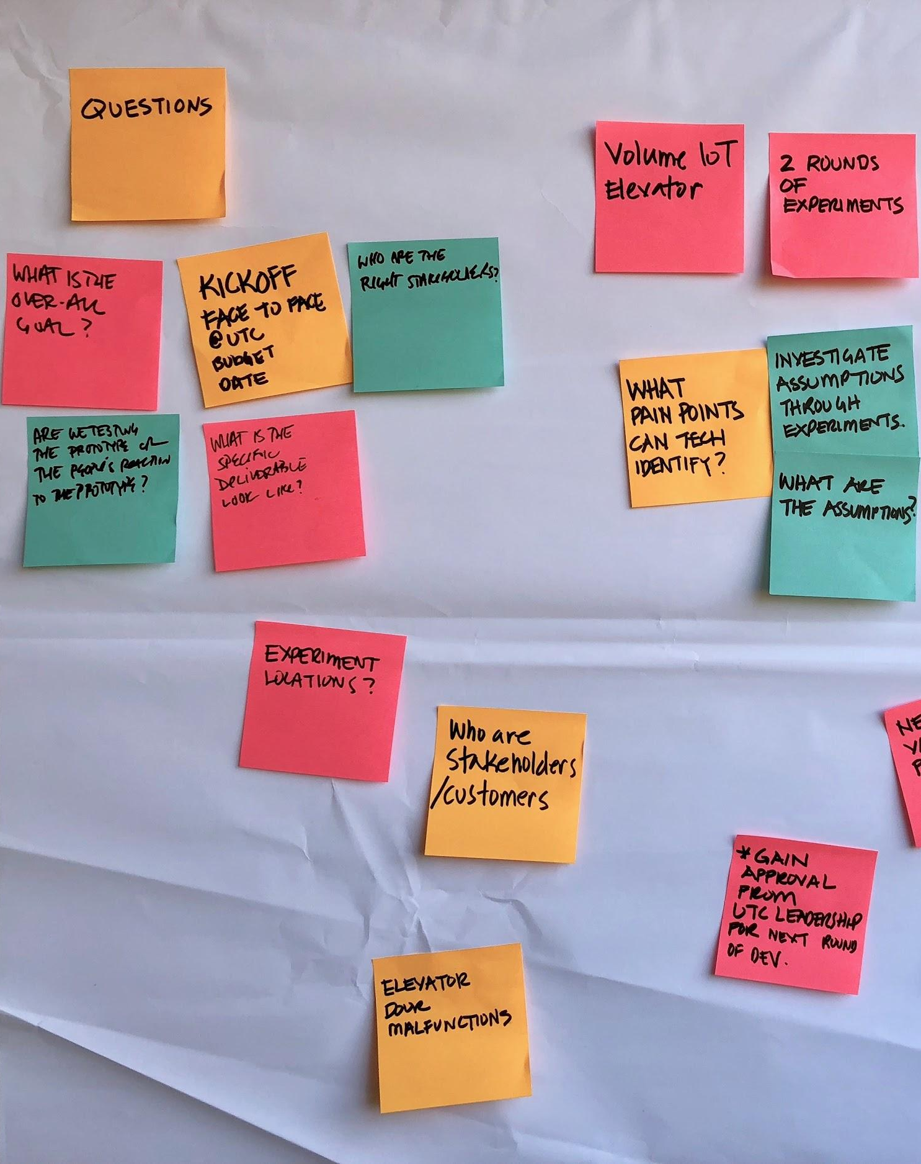
Project objectives
OVERVIEW
Digitize 1095-B form on VA.gov so Veterans can easily access the form and download the form for their records.
04-05 Sprint 5 Demo
Overview

Slide 9

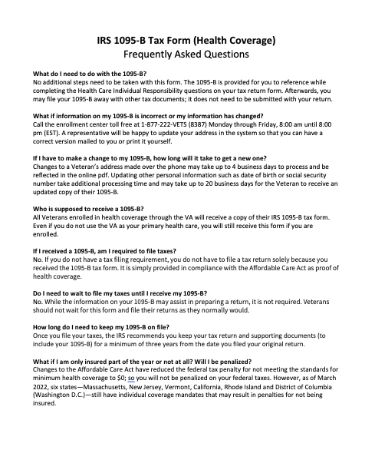

1
DESIGN
We presented our finished product and informational materials to our business owner at the Health Enrollment Center
User Story: Update HEC documents to reflect changes from sitewide
User Story: Update product guide to reflect changes from sitewide content review
User Story: Iterate on designs from Business Owner feedback (round 2)
User Story: Transmit final draft of HEC documents to Tarsha
User Story: Update HEC products based on business owner feedback (final version)
User Story: Create video walk through of final designs for HEC
User guide, factsheet, FAQs, video, product guide, mobile designs: no 1095-B avail, success, technical error, unauthenticated
04-05 Sprint 5 Demo
Design
9

Slide 10
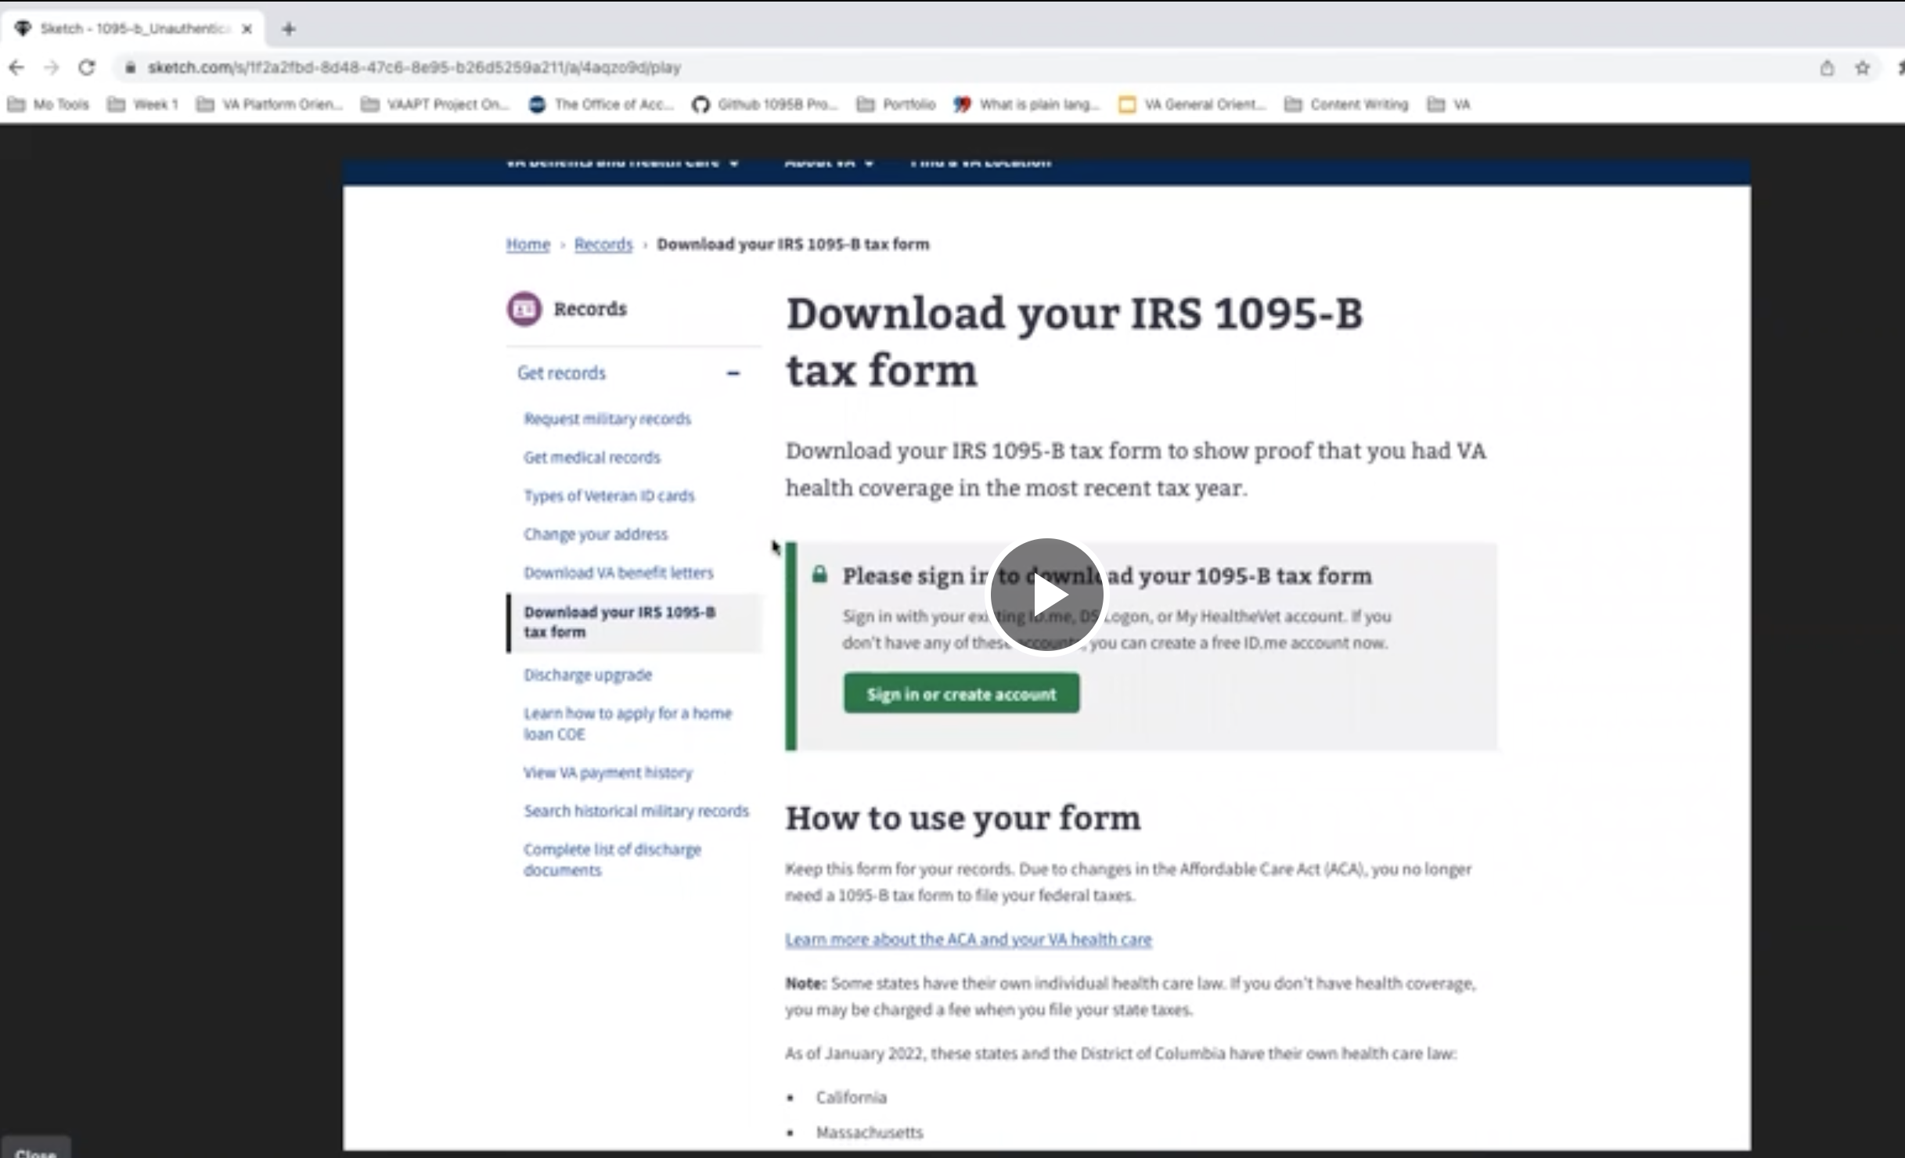
1
DESIGN
We prepared the VA call center to answer questions about our product
User Story: Collaboration cycle: Contact center review
User Story: Update call center product video to reflect changes from sitewide content
New product video delivered to Jason Woodman and Steven Tarlow on April 1
All Contact Center review deliverables are with the Jason and Steven, and we're awaiting feedback
video & ticket
04-05 Sprint 5 Demo
Design
10

Slide 11
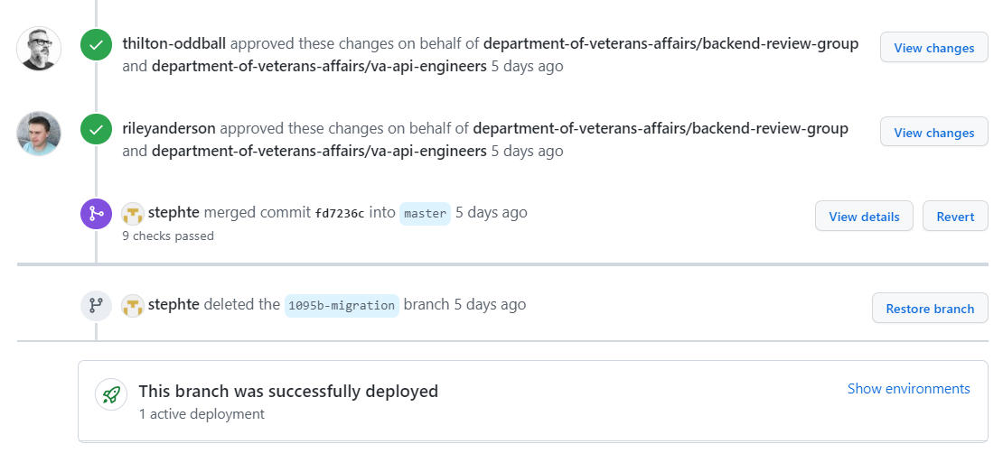
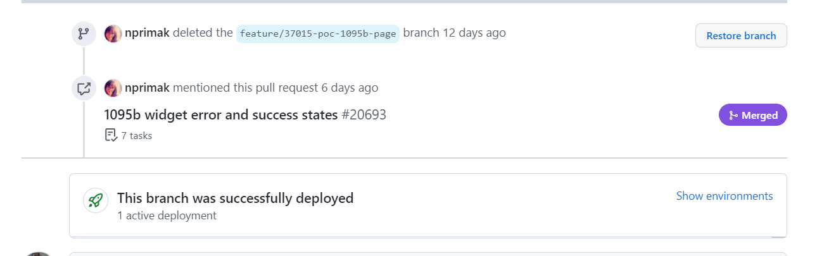
2
TECH
We completed product build in anticipation of entering staging review on April 8
User Story: Update model for encryption
User Story: Update AWS script
User Story: Front end testing
User Story: Building out front end for error states
User Story: Collaboration cycle: Staging review
Model and encryption and AWS scripts done
Tests need to be written for these
Front End error states are completed and merged
Alternative forms of testing approved by collaboration cycle PM
Staging review on Friday April 8
Ticket #G9457, 9423, 9430, 20693, 20619
04-05 Sprint 5 Demo
Tech
11

Slide 12
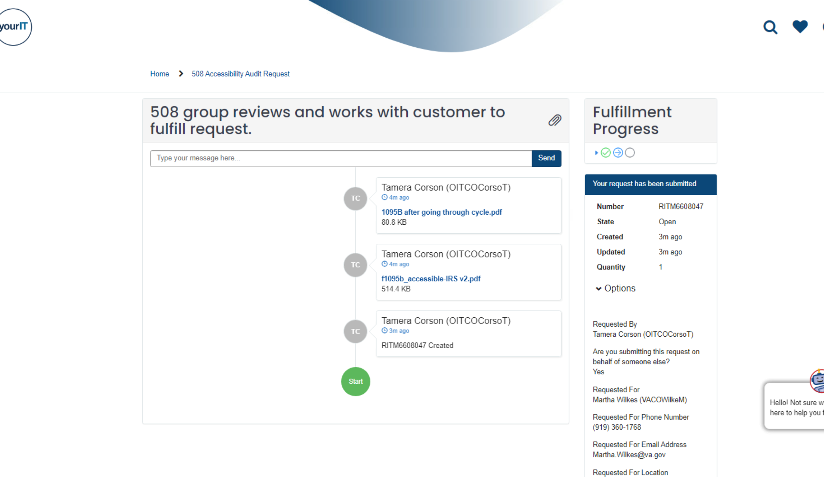
We tested for accessibility compliance and created a path for future improvements
3
PRODUCT
User Story: Explore options in fixing language parameters on PDF
User Story: 1095-B Team Staging Review Accessibility Checklist
User Story: Aligned on path forward regarding PDF accessibility
User Story: Draft notice to VA Accessibility Office regarding product non-compliance
The IRS created a new 1095-B PDF that passed all but one Adobe accessibility test (Table Regularity)
When we populate it with data and create a new file, we get several new errors
Primary language
Title
Tab order
Tagged form fields
Regularity
We have submitted the PDF for a 508 audit, with details of our efforts, to the VA's 508 office, in hopes they can give further guidance
Testing, prestaging tests, platform guidance & your IT ticket
04-05 Sprint 5 Demo
Product
12

Slide 13
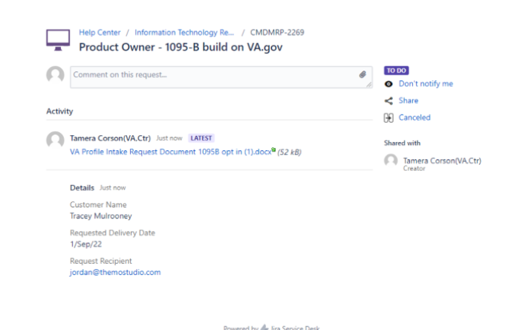
We laid the groundwork for opting into digital delivery and helped start the process for Profile to build opt in
3
PRODUCT
User Story: Submit intake forms for VA Profiles (opt-in)
User Story: Draft email for opt-in notification requirements
From: U.S. Department of Veteran Affairs
Subject: Your IRS 1095-B tax form is now available online
Dear [First_Name],
In an effort to reduce paper and provide more convenient options for Veterans to access documents, we have now made the IRS 1095-B tax form (proof of health coverage) available online. Visit https://www.va.gov/records/download-your-irs-1095-b to download and/or print a copy of this form for your records.
Go Paperless. If you would like to opt-in to paperless delivery and no longer receive your 1095-B in the mail, please update your notification preferences in your profile at: https://va.gov/profile/notifications
Thank you,
VA.gov
Draft opt-in templates, ticket & update 4/4
04-05 Sprint 5 Demo
Product
13

Slide 14
Blockers for 1095-B launch
BLOCKER | OWNED BY | ACTION NEEDED | DATE ENTERED | STATUS | NOTES
Legal review | Tarsha Tremble (Business Owner) | Business Owner is seeking a POC with the Office of General Counsel to understand requirements for legal review and timeline | Sprint 3 - 3/2/22 |  | Team had previously confirmed with Business Owner that legal review was not needed. Business Owner clarified that legal review would be needed as of March 2nd
Frontend re-design by sitewide content team | Danielle Theirry, Sitewide Content Team | Sitewide Content has redesigned our front-end designs when building it in Drupal to comply with Drupal standards 1095-B team to handoff the download button in widget to Sitewide content, then Sitewide content team will pull in the widget to the front end and own the full front end Sitewide Content to own and manage any changes on the front end as part of their timeline Sitewide Content to define launch date, since they own front end | Sprint 4 – 3/15/22 |  | Team passed the following Collaboration Cycle milestones, with our version of designs: Midpoint Review on 3/04/22 Content & IA Review on 3/09/22 (finalized URL)
PDF Accessibility | Tarsha Tremble (Business Owner) | Team received PDF from IRS, but PDF is still not accessible once it is populated with data | Sprint 3 – 3/3/22 |  | Team is escalating to 508 office for additional guidance
04-05 Sprint 5 Demo
1095-B Blockers

Slide 15
1095-B Remaining actions, with external dependencies
ITEM | WORK STREAM | ACTION NEEDED | TARGET COMPLETE DATE | PREREQUISITE
Tech refinements & testing | Tech | Update backend and react widget as needed based on staging review and UAT feedback Build out and conduct testing | March – end of Sprint 5 | Product complete in staging
UAT | Product & Tech | Follow Collaboration Cycle guidelines for UAT Identify Veterans within VA to conduct UAT, send access, and follow up to ensure testing complete | March – April | Product must be complete in staging
1095-B Opt-in | Product | Follow up with HEC and Profiles team to ensure opt-in is done Update draft communications and announcement plans, based on when opt-in will be launched | April - May | HEC and Profiles commitment to building opt-in
Legal Review | Product | Work with Tarsha to complete legal review | March – April | POC name from Tarsha
Post Launch Check- In | Product | Complete Collaboration Cycle milestone to KPIs post launch | TBD (One month after launch and announcement) | Product launched in prod
Links from VA.gov pages to 1095-B | Product & Design | Work with IA team to have other identified pages within VA.gov (e.g., ACA page) link to the 1095-B page Work with IA team to have 1095-B page added to navigation and be found in VA.gov search | April or later | Product launched in prod; aligned on comm plan with Tarsha, Tracey
1095-B update strategy | Product | Align on who will own 1095-B long term, including updating the PDF template each year | April or later | Product complete and launched in production
Communications to announce launch | Product & Design | Work with Tarsha and HEC team to refine drafted communications and align on plan and timeline to announce 1095-B launch to Veterans Work with VA Notify team to build and launch communications on their platform | October - December | Product launched in prod; aligned on communication plan with Tarsha/Tracey
04-05 Sprint 5 Demo
1095-B Remaining actions

Slide 16
Community Care
SPRINT 5 DEMO
04-05 Sprint 5 Demo

Slide 17

Project objectives
OVERVIEW
Draft a current state Journey Map to enable identification of impactful, near-term opportunities for integrating Community Care into VA.gov
Focus areas:
Secure messaging
Medical records
Prescriptions
Debt/Billing
Conduct product and tech discovery to assess complexity, scope, & feasibility
04-05 Sprint 5 Demo
Overview

Slide 18
We laid out the potential deliverables into a workplan to show where we could help, given current timelines
WE ARE HERE
SPRINT 5
SPRINT 6
Week 10: 03/23 – 03/30
Week 11: 3/30 – 04/06
Week 12: 04/06-04/13
Week 13: 04/13-04/20
Product & Delivery
Build Backlog
Discovery
1095-B
Track value & viability to business & partners
Stakeholder interviews
User Experience & Design
Immersion
Care Navigator Research TBD
Draft Current State Journey Map
Ongoing Journey Map Refinement
1095-B
Engineering & Development
VAOS Data Bindings
1095-B
Tech Integrations Feasibility & Projection
We recommend waiting on further Veteran Research until there's additional understanding on around tech feasibility and if needed for further prioritization
04-05 Sprint 5 Demo
Community Care

Slide 19
We assessed what should go into a plan to develop a solution for Community Care
Understand
Synthesized themes from research
Current state user journey map
Veteran pain points
Technology research on existing landscape
Envision the Future
Ideation for potential future state near-term solutions
Refined user journey map, illustrate future state with near-term solutions
Tech potential architecture for future state, with dependencies
Open questions still to be answered
Plan for future
Prioritized future state solutions
Phased roadmap (now, next, later) - aligning on MVP
Epics and user stories
04-05 Sprint 5 Demo
Community Care

Slide 20
We conducted business partner interviews and synthesized themes we heard
1
DESIGN
User Story: CC: Conduct product discovery through business partner interview(s) to pull insights
There are many disparate systems (40-43), which makes it hard to get reliable data (and/or sync data)
There are many steps in the process to receive CC; some parts can be done online, while others are manual
Trickle down to Veteran users, causing frustration and pain points, i.e., "why should go online if I still have to call or wait for a call from someone?"
Leads to high abandonment rates
Many Veterans lack general awareness of the benefit and/or don't fully utilize it
Not enough transparency into the billing process contributes to knowledge gaps for Veterans
A major pain point is understanding how co-pays & billing work as well as comprehension of the statement
There's a lot of information on CC & co-pays, but it's hard to find and not written clearly
Billing and Debt consolidation may have some MVP's that more readily reveal themselves (VA technical guidance)
The Veteran is the integrator: Understanding/getting records to and from CC and VA doctors is a pain point for both Veterans as well as providers
Prescriptions are a persistent pain point: tracking holistically, filling at the VA or externally (e.g., Walgreens), and ensuring benefit coverage of CC prescribed medications; early VA technical guidance advises against starting with this product feature since the outbound capability is in flux with EMR (chasing the wind) and the program office has a lot of work to also figure out how to be compliant (state-to-state especially) on prescription tracking
There's drastic drop-off rate after Veterans are referred (12 million Veterans have been referred since March 2019, but only 3 million Veterans have completed CC); About 5,000 referrals have occurred over the last 12 months*
*Business owner interview with Alysse Mengason – Communications, Office of Community Care
04-05 Sprint 5 Demo
Community Care

Slide 21
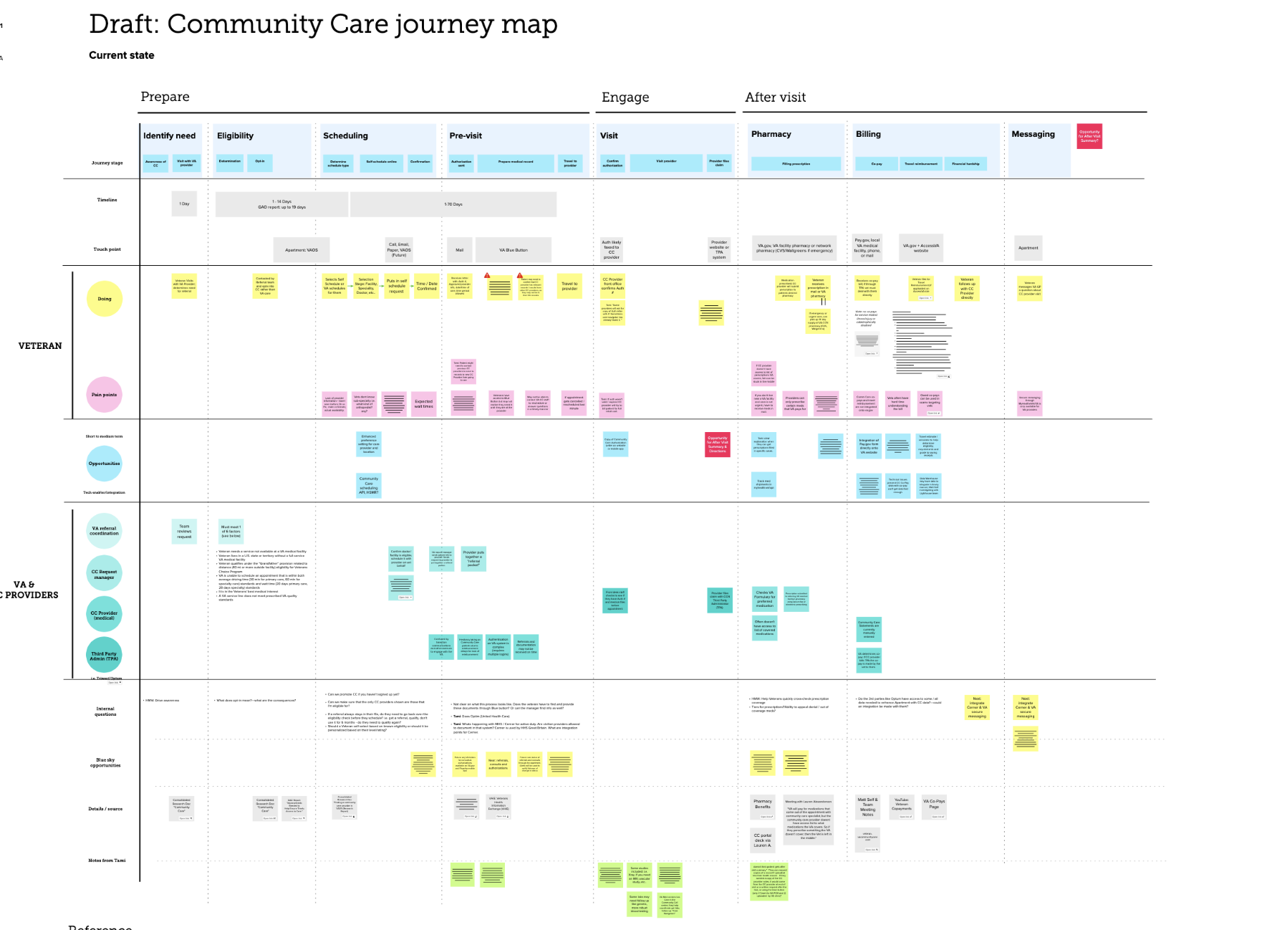
We synthesized what we learned into a draft of a journey map
1
DESIGN
User Story: CC: Conduct initial product discovery through review of current MHV work product and past documentation
User Story: CC: Conduct product discovery through business partner interview(s) to pull insights
Daniel T (Taliaferro, Trent D.): "You've chosen one of the most integrated and complicated programs within health to look at."
Mural
04-05 Sprint 5 Demo
Community Care

Slide 22
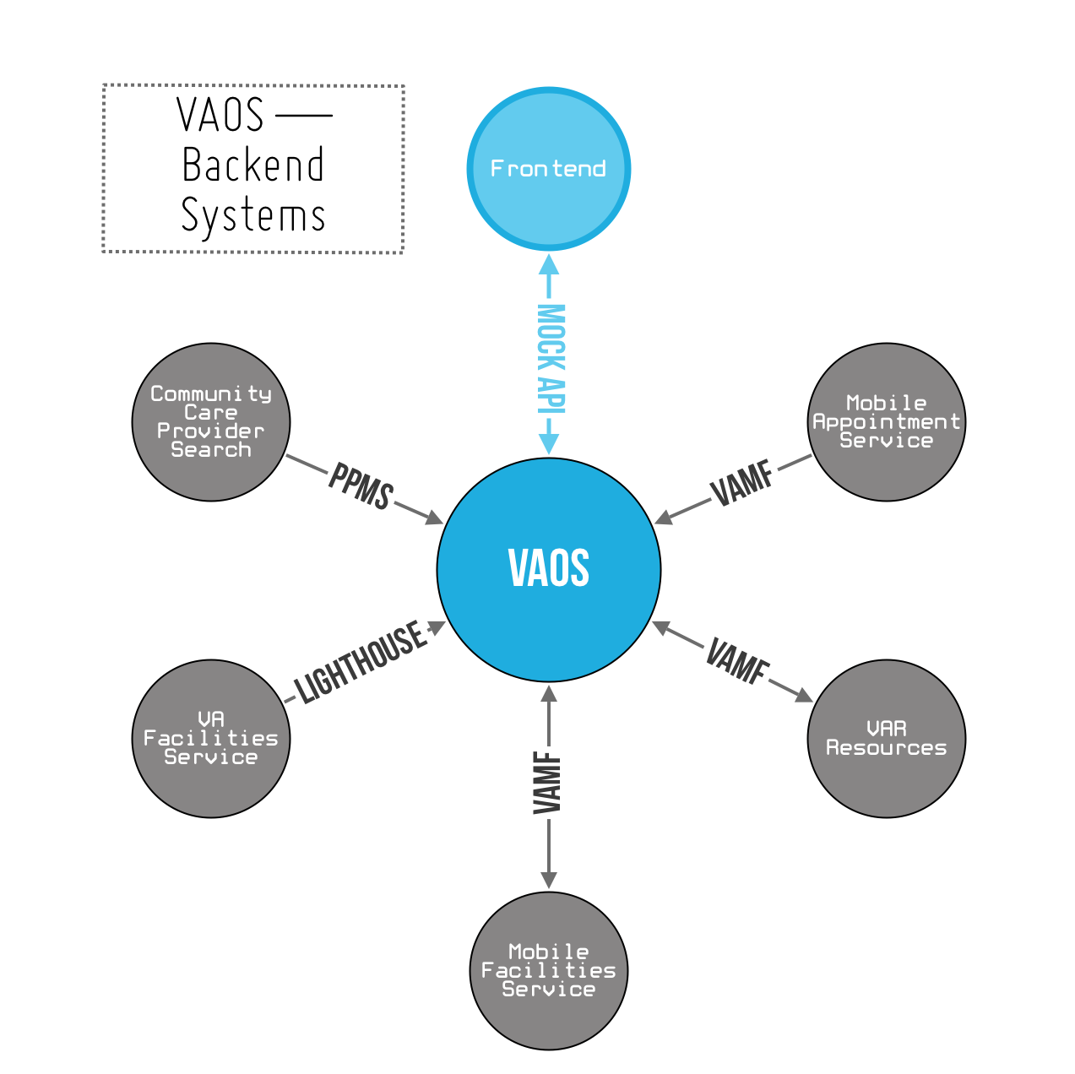
We are conducting technical discovery to get a baseline understanding of systems involved in community care
2
PRODUCT + TECH
User Story: CC: Conduct initial product discovery through review of current MHV work products
User Story: CC: Conduct initial discovery into APIs
User Story: CC: Conduct initial discovery into data sources used in the health apartment
CC Eligibility API
Drive times only
Appointment wait times
Best Medical Interest
Quality Standards
Need to confirm other related APIs
Health Apartment data sources used
Health Apartment Features List
Next Steps:
George Brittingham: Overview of CC APIs & Architecture
CC IA
04-05 Sprint 5 Demo
Community Care

Slide 23
Sprint Deliverables
SPRINT 5 DEMO
04-05 Sprint 5 Demo

Slide 24
Sprint 5 Deliverables 1095-B (1 of 4)
EPIC | STORY | ESTIMATE | ASSIGNED | OUTPUT | REVIEWED WITH VA-PO | SPRINT TEAM GOAL COMPLETED?
Design | #39042 Update HEC documents to reflect changes from sitewide | 2 | Carl | FAQs User guide Factsheet | 03/25/22 | ✓
Design | #38708 Update product guide to reflect changes from sitewide content review | 2 | Carl | Product guide (revised) | 03/25/22 | ✓
Design | #38038 Iterate on designs from business owner feedback (round 2) | 1 | Grace | Mobile, no 1095-B avail Mobile, success Mobile, tech error in download Mobile, unauthenticated | 03/29/22 | ✓
Design | #38902 Transmit final draft of HEC documents to Tarsha | 1 | Carl Jordan | FAQs User guide Factsheet | 03/15/22 | ✓
Design | #39275 Update HEC products based on business owner feedback (final version) | 2 | Carl | FAQs User guide Factsheet | 04/05/22 | ✓
Design | #39172 Create video walk through of final designs for HEC | 2 | Carl James | HEC Video presentation | 04/05/22 | ✓
Design | #38392 Collaboration cycle: Contact center review [1095-B] | 0 | Carl Jordan | Product video (revised) Ticket | 04/05/22 | ✓
Design | #38709 Update call center product video to reflect changes from sitewide content | 2 | Carl | Video | 03/25/22 | ✓
Design | #39446 Draft email for opt-in notification requirements | 3 | Carl | Draft, opt-in notification templates | 04/01/22 | ✓
04-05 Sprint 5 Demo
Sprint 5 Deliverables

Slide 25
Sprint 5 Deliverables 1095-B (2 of 4)
EPIC | STORY | ESTIMATE | ASSIGNED | OUTPUT | REVIEWED WITH VA-PO | SPRINT TEAM GOAL COMPLETED?
Tech | #39227 Update model for encryption | 2 | Teagan | Ticket #G9457 Ticket #G9423 Ticket #G9430 | 04/05/22 | ✓
Tech | #39226 Update AWS script | 3 | Teagan | Ticket #G9457 Ticket #G9423 Ticket #G9430 | 04/05/22 | ✓
Tech | #38097 Front end testing | 5 | Nadya | Ticket #G20619 Ticket #G20693 | 04/05/22 | ✓
Tech | #39290 Building out front end for error states | 5 | Teagan | Ticket #G20619 Ticket #G20693 | 04/05/22 | ✓
Tech | #38267 Explore options in fixing language parameters on PDF | 5 | Teagan Nadya | Testing your IT ticket | 03/29/22 | ✓
Tech | #38387 1095-B Team staging review accessibility checklist | 3 | James Jordan Nadya Teagan | Ticket | 04/05/22 | ✓
04-05 Sprint 5 Demo
Sprint 5 Deliverables

Slide 26
Sprint 5 Deliverables 1095-B (3 of 4)
EPIC | STORY | ESTIMATE | ASSIGNED | OUTPUT | REVIEWED WITH VA-PO | SPRINT TEAM GOAL COMPLETED?
PM | #38903 Aligned on path forward regarding PDF accessibility | 0 | Jordan | Testing Platform guidance Ticket | 03/29/22 | ✓
PM | #39304 Draft notice to VA Accessibility Office regarding product non-compliance | 2 | Tami Jordan | Ticket | 04/01/22 | ✓
PM | #38039 Understand what is needed for legal review and impact to timeline | 1 | Munish | NR | 03/25/22 | ✓
PM | #39020 Submit intake forms for Profiles and HEC | 2 | Tami Jordan | Ticket Update 4/4 | 04/01/22 | ✓
04-05 Sprint 5 Demo
Sprint 5 Deliverables

Slide 27
Sprint 5 Deliverables – CC
EPIC | STORY | ESTIMATE | ASSIGNED | OUTPUT | REVIEWED WITH VA-PO | SPRINT TEAM GOAL COMPLETED?
Design | #39072 CC: Conduct initial product discovery through review of current MHV work product and past documentation | 5 | James Carl | Journey Map | 04/05/22 | ✓
Design | #39071 CC: Conduct product discovery through business partner interview(s)to pull insights | 8 | James Jordan Kit | Insights; p. 20 of Demo Deck Journey Map | 04/05/22 | ✓
Tech | #39176 CC: Conduct initial discovery into data sources used in the health apartment | 5 | MunishJordan Teagan | CC IA | 04/05/22 | ✓
Tech | #39177 CC: Conduct initial discovery into API’s | 5 | Munish Jordan Teagan | CC IA | 04/05/22 | ✓
04-05 Sprint 5 Demo
Sprint 5 Deliverables

Slide 28
Preview of Sprint 6
SPRINT 5 DEMO
04-05 Sprint 5 Demo

Slide 29
Sprint 6 will focus on
 | Next sprint demo: April 19
PRODUCT
1095-B: UAT
1095-B: Opt-In follow up
CC: Product discovery to assess complexity, value and viability
CC: Identify MVP
1
Stories subject to change during Sprint planning
2
DESIGN
CC: High Fidelity Journey Map
CC: Phased design roadmap
3
TECH
1095-B: Post Staging refinements & UAT
CC: Tech discovery to assess complexity and feasibility
CC: Current state high level architecture
CC: Phased tech roadmap
04-05 Sprint 5 Demo
Preview of Sprint 6

Slide 30
Sprint 6 will run April 6 to April 20th
Owned by design team
Owned by product/ engineering team
Release
WE ARE HERE
SPRINT 2
SPRINT 3
SPRINT 4
SPRINT 5
SPRINT 6
Week 4: 02/09 – 02/16
Week 5: 02/16 – 02/23
Week 6: 02/23 – 03/02
Week 7: 03/02- 03/09
Week 8: 03/09 – 03/16
Week 9: 03/16 – 03/23
Week 10: 03/23 – 03/30
Week 11: 3/30 – 04/06
Week 12: 04/06-04/13
Week 13: 04/13-04/20
Product & Delivery
Identify Change Management or Communications Plan
1095-B Handover plan - Prepare for launch
1095-B Legal Review
Prioritized backlog
1095-B Post Staging Cleanup
CC Discovery
CC Discovery – Track Value, Complexity, Viability
User Experience & Design
Voice of Veteran
Testing prep & recruiting
Stakeholder Interviews
Voice of Veteran
Design iterations
Design iterations
Current State Journey Map
Ongoing Journey Map Refinement
Engineering & Development
POC for data flow
Build solution (form UI, data connections, storage, etc.)
Tech Integrations
Collaboration Cycle
Midpoint Review
Analytics Review
MVP Launch Date Dependent on Legal Review Completion
Privacy & Security review
Staging Review
Research Plan Review #2 (wireframes)
Content & IA Review
Contact Center Review
*Does not show post-MVP Validate phase meetings in Collaboration Cycle, such as Full Accessibility Audit and Post-Launch Check In; Contact Center Review adjusted to 3 weeks before launch as approved by Jason Woodman
Preview of Sprint 6

Slide 31
Appendix
SPRINT 5 DEMO

Slide 32
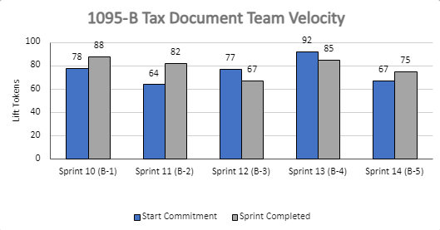
1095-B Sprint team velocity
 | Velocity details Velocity estimated in story points, using Fibonacci Velocity in Sprint 5 accounted for 10 team members 75 total story points were completed; Team committed to 67 story points at beginning of the sprint, 9 were blocked, 8 no longer relevant, and 25 additional story points added. 9 story point blocked due to postponement of staging review and have been added to next sprint work 8 story points were removed due to being superseded / enveloped by other stories 25 story points were added with two stories brought forward due to tech capacity (5), three stories were added midcycle by business owner request (7), three stories were created midcycle after receiving new knowledge in accessibility discovery and developing community care exploration (12), and one story was added for platform offboarding (1). All collaboration cycle events were not assigned story points * 9 story points are not accounted for in deliverables slides (24-26); VA platform onboarding /offboarding (6), collaboration cycle feedback Mural (3)
04-05 Sprint 5 Demo
Appendix
32

Slide 33
Project risks and mitigation strategies
Munish to update
Submitted as part of the Monthly Report for March
RISK AND IMPACT | MITIGATION STRATEGY | DATE |  | STATUS | NOTES
 |  | ENTERED | CLOSED
IRS stakeholder is outside of VA ecosystem. Building without guidance or legal review regarding compliance with IRS regulation could result in risk. | Conduct research on available information surrounding current IRS 1095-B tax form regulations. Seek legal review through VA resources as directed by VA-PO and Business Owner | 1/20/22 | 2/11/22 |  | VA Business Owner clarified that IRS review is not needed
Team had previously confirmed with Business Owner that legal review was not needed. Business Owner clarified that legal review would be needed as of March 2nd | Business Owner is seeking a POC with the Office of General Counsel to understand what is needed and potential launch impact | 3/2/22 |  |  | Launch blocker
Data requires storage in a S3 bucket that the enrollment system can have access to in production; process to create the staging and production bucket does not have a clear timeline. Without the S3 bucket in prod with enrollment system access, product cannot be built in prod | Daily follow-ups with Jesse House and Mike Chelan (infrastructure team) | 3/1/22 |  |  | S3 bucket now in place. Risk resolved.
Business owner raised User Acceptance Testing should be done with HEC Call Center | Requested Business Owner to schedule UAT with required individuals for mid-March and book as early as possible | 3/2/22 | 3/25/22 |  | Business owner confirmed that UAT can be done through Collaboration Cycle and does not have to be done with HEC team
Feedback from Content and IA Review has taken over a week to come in; feedback is changing our proposal for the H1 and delaying confirmation of where the 1095-B landing page should live, which in turn delays our ability to complete the front end (top nav and side nav bars) | Design team pushing on IA team to confirm final answer of where 1095-B landing page should live and what the H1 header title should be | 03/04/22 | 3/8/22 |  | URL confirmed 3/7 EOD; IA review now closed
Designs were approved as part of Midpoint Review. Afterwards, Sitewide Content stated they would need to build our front end in Drupal and change our designs, impacting our in-flight build. | Design team met with Sitewide Content to align on redesigned front end. Tech working with Sitewide Content to send over our dynamic widget to be pulled into their static front end. Sitewide Content now owns the front end build. | 3/10/22 |  |  | Launch date dependent on Sitewide Content ability to launch front end
04-05 Sprint 5 Demo
Appendix
33

